Slide 1
HEALTHCARE TECHNOLOGY · ACADEMIC PROJECT REVIEW
Remote Patient
Health Monitoring System
Connected sensing, secure communication, and actionable alerts for continuous clinical observation.
KADIRI PRASAD
323129520065

Slide 2
THE GAP IN PERIODIC CARE
Periodic checkups leave dangerous gaps
A patient can change between scheduled visits, while a manual assessment may reveal deterioration only after it has become difficult to miss.
01
02
03
Change happens between visits
Sudden deterioration is hard to detect early
Teams need a continuous view
Chronic illness, elderly, and post-operative patients can change between scheduled visits.
Manual assessments make sudden deterioration difficult to detect early.
Healthcare teams need continuous visibility and faster escalation.

Slide 3
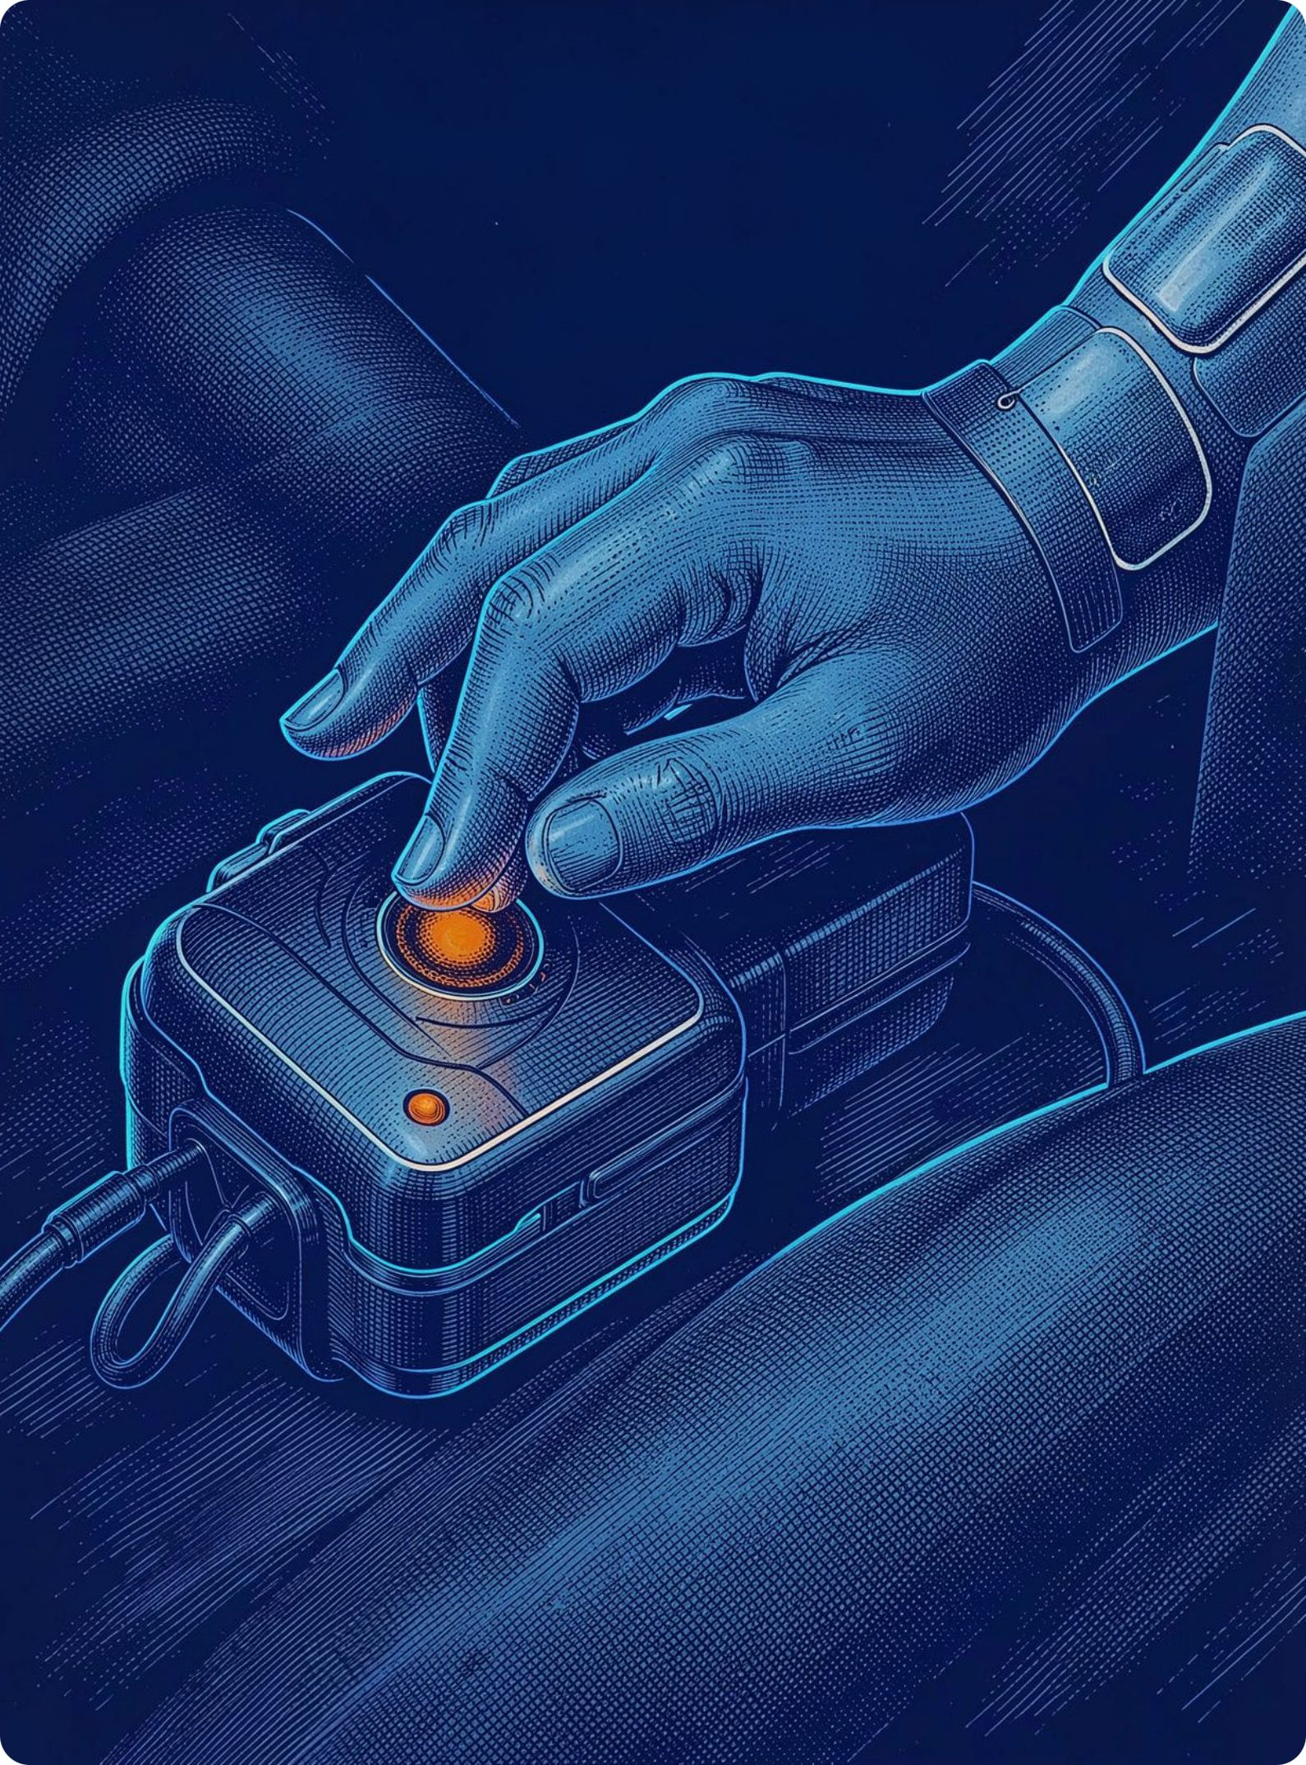



CONNECTED SENSING
IoT sensors turn vital signs into a live patient picture
Heart rate, body temperature, and blood oxygen sensors collect recurring readings. An IoT communication module transmits measurements from the patient to the monitoring platform. Cloud-based storage supports centralized access and historical review.

Slide 4
SYSTEM WORKFLOW
From bedside reading to clinical response
The platform turns recurring measurements into a defined response path.
01
02
03
04
Sense
Transmit
Compare
Notify
Sense vital signs continuously.
Transmit readings securely in real time.
Compare values with configured health thresholds.
Notify the right responder when an abnormal condition is detected.

Slide 5
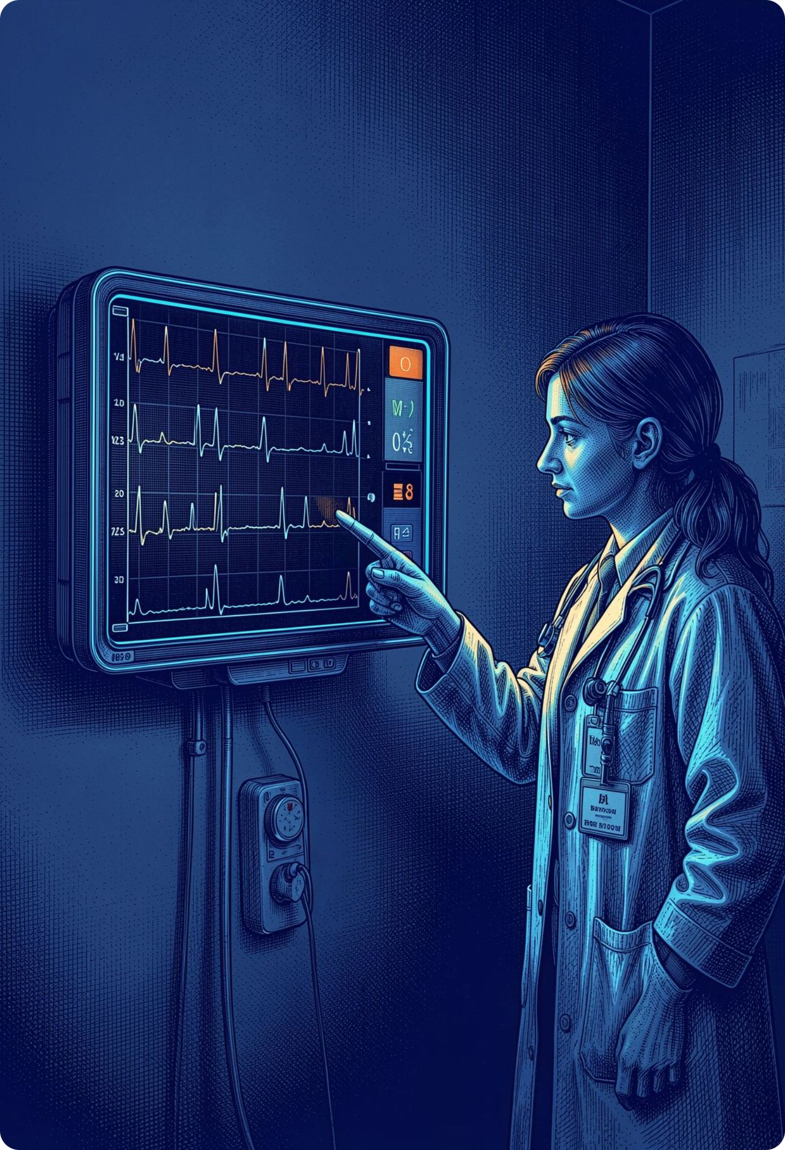
One dashboard keeps every patient signal in view
Real-time vital parameters and patient status
Historical trends for ongoing clinical observation
Alert history for follow-up and accountability
Device performance information to identify connectivity or sensor issues

Slide 6
ESCALATION PATH
Emergency alerts shorten the path to intervention
1
2
3
Detect
Route
Prioritize
Abnormal readings trigger automated notifications
Doctors, caregivers, or emergency contacts can be selected by escalation policy
Clear alert status helps teams prioritize urgent cases

Slide 7
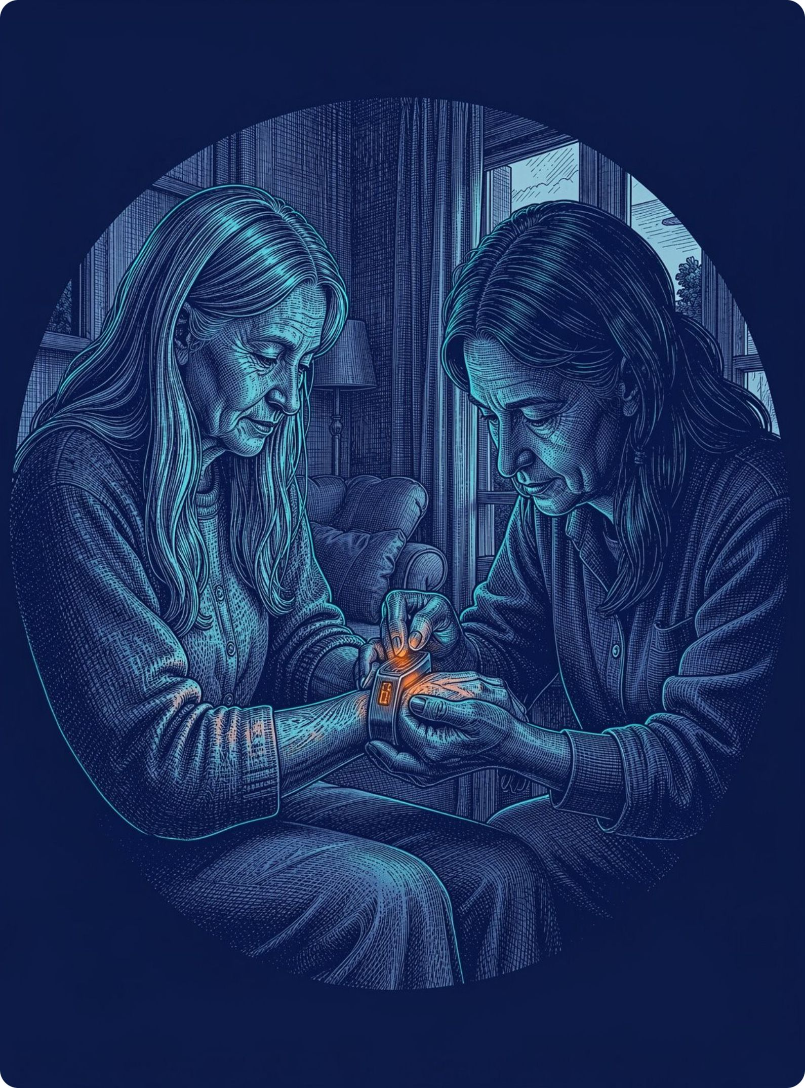
CARE BEYOND THE HOSPITAL
The platform fits care beyond the hospital
Hospitals and clinics
Elderly care centers and home healthcare services
Post-operative follow-up and telemedicine programs
Scalable architecture for multiple patients, devices, and care teams

Slide 8
CLINICAL VALUE
Continuous observation
makes timely care possible
The system extends clinical oversight beyond scheduled encounters by connecting sensing, communication, and response.
01
02
03
04
Earlier awareness
Prompt intervention
Remote oversight
Connected response
Improves patient safety through earlier awareness of change.
Supports early detection and prompt medical intervention.
Extends clinical oversight into homes and remote settings.
Combines connected sensing, secure communication, and actionable alerts.

